Slide 1
Jerry 7/18

Slide 2
Motivations
Bottleneck: Collision detection
50%+ of computation is used on collision ALONE
Step size limits possible movement per detection
How do we provide penetration free WITHOUT detection?
Penetration free deformations:
Deform the object to approximately match past movement BEFORE full detection.

Slide 3

Problem statement
Problem: Deform current position $x_{0}$ to be close to the predicted position $\tilde{x}≈2x^{t}−x^{t−1}$such that the line from $x_{0}$to $x$has no penetrations.
$$\min_{x}{{\left|x−\tilde{x}\right|}^{2}}$$
$$s.t. ∀t∈\left[0, 1\right] :x_{0}+t \left(x−x_{0}\right) is penetration free$$
We want to …
Maximize the likelihood that $\tilde{x}$ is within the trust region of $x$
The closer we are, the less detections we need!
Provide non-penetration guarantee
Deformation gradient > 0 everywhere
Use no expensive neighborhood queries

Slide 4
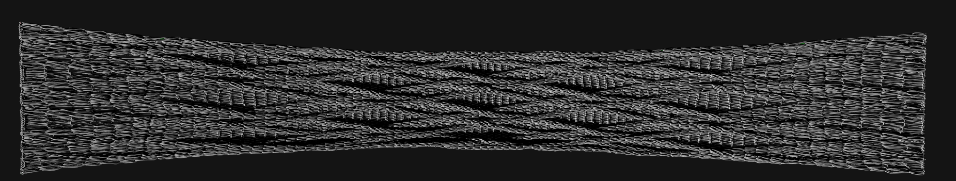
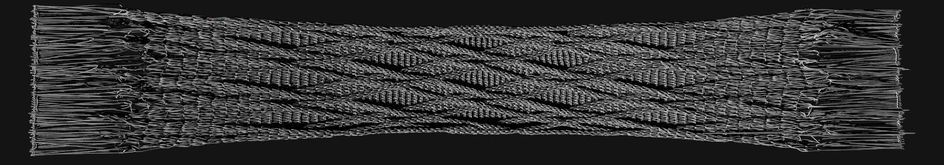
Example: Affine least squares
Fit affine transformation to deformation and apply to position before collision query.
Affine transformations mean guaranteed penetration free

Slide 5

Affine linear least squares
For the i’th vertex, the target motion is $∆x_{i}$ such that the next position is $x_{i}+∆x_{i}$
An affine transformation takes the form
$$f\left(x\right)=\left[\begin{matrix}a & b & c \\ d & e & f \\ h & j & m\end{matrix}\right]x_{i}+\left[\begin{matrix}o \\ p \\ q\end{matrix}\right]≈∆x_{i}$$
We want it approximately match $∆x_{i} ∀i$
Ie. $\min{\sum_{i}{{\left|f\left(x_{i}\right)−∆x_{i}\right|}^{2}}}$

Slide 6

Rewriting
We can rewrite
$$f\left(x_{i}\right)−∆x_{i}=\left[\begin{matrix}ax_{x,i}+bx_{y,i}+cx_{z,i}+o 1 \\ dx_{x,i}+cx_{y,i}+fx_{z,i}+p 1 \\ hx_{x,i}+jx_{y,i}+mx_{z,i}+q 1\end{matrix}\right]−∆x_{i}$$
$$x_{i},∆x_{i}, and 1 are all known!Move constants to matrix A_{i} s.t.$$
$$f\left(x_{i}\right)−∆x_{i}=A_{i}\left[\begin{matrix}a \\ ⋮ \\ q\end{matrix}\right]−∆x_{i}=A_{i}v−∆x_{i}$$

Slide 7

More rewriting
$$\sum_{i}{{\left|f\left(x_{i}\right)−∆x_{i}\right|}^{2}}=\sum_{i}{{\left|A_{i}v−∆x_{i}\right|}^{2}}$$
$$={\left|\left[\begin{matrix}A_{0} \\ ⋮ \\ A_{N−1}\end{matrix}\right]v−∆x\right|}^{2}={\left|Av−∆x\right|}^{2}$$
$$\min{\sum_{i}{{\left|f\left(x_{i}\right)−∆x_{i}\right|}^{2}}}=\min{\frac{1}{2}{\left|Av−∆x\right|}^{2}}$$

Slide 8
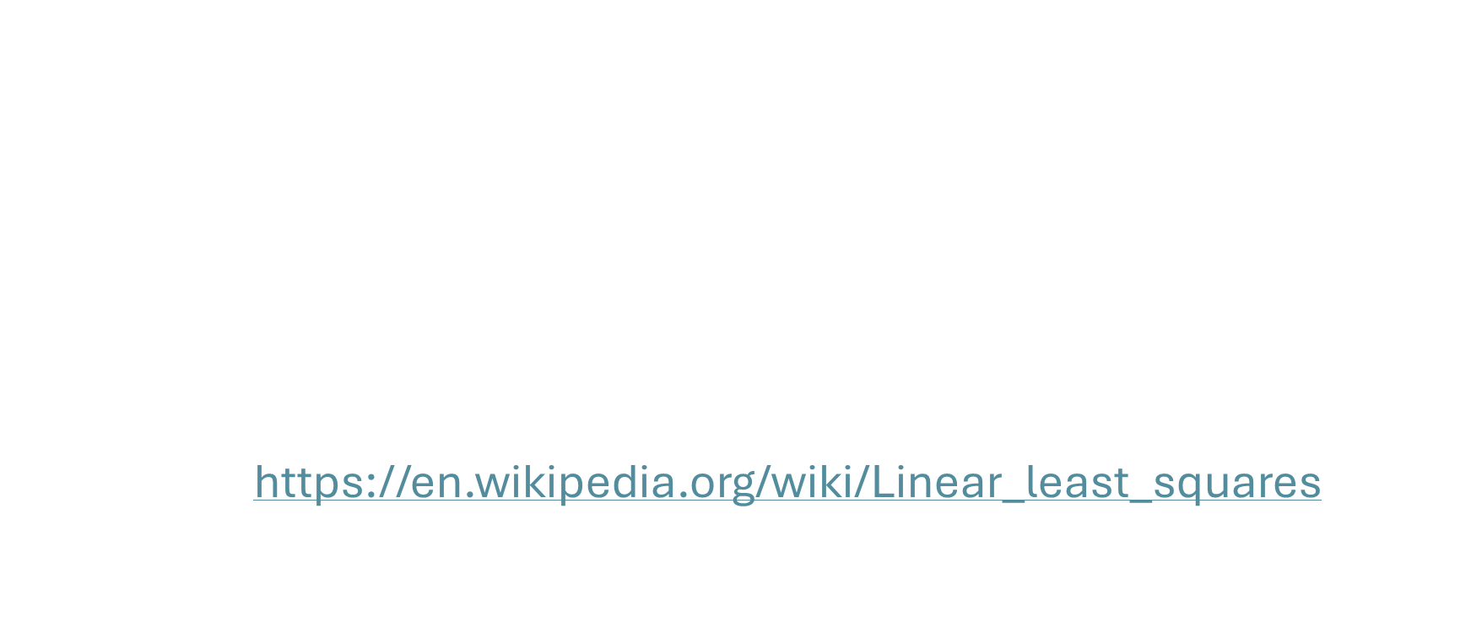
Linear least squares
This is just linear least squares!
$$\min_{v}{\frac{1}{2}{\left|Av−∆x\right|}^{2}}$$
$$→v={\left(A^{T}A\right)}^{−1}A^{T}∆x$$
See https://en.wikipedia.org/wiki/Linear_least_squares
for linear least squares math

Slide 9
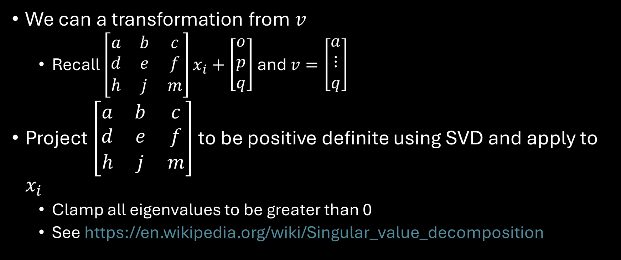
Affine transformation
We can a transformation from $v$
Recall $\left[\begin{matrix}a & b & c \\ d & e & f \\ h & j & m\end{matrix}\right]x_{i}+\left[\begin{matrix}o \\ p \\ q\end{matrix}\right]$ and $v=\left[\begin{matrix}a \\ ⋮ \\ q\end{matrix}\right]$
Project $\left[\begin{matrix}a & b & c \\ d & e & f \\ h & j & m\end{matrix}\right]$ to be positive definite using SVD and apply to $x_{i}$
Clamp all eigenvalues to be greater than 0
See https://en.wikipedia.org/wiki/Singular_value_decomposition

Slide 10
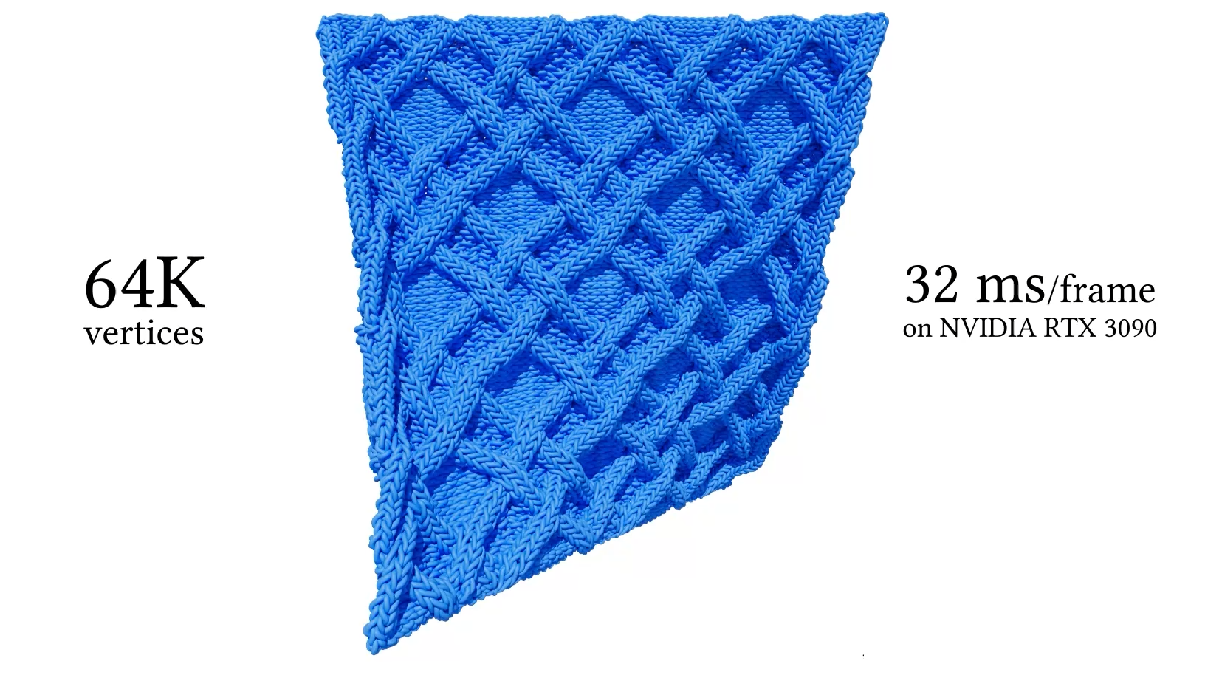
Test case: Can we do better?
The meshes Anka has in mind
I can provide sample frame data for <- this
Slightly easier as line segments

